Slide 1
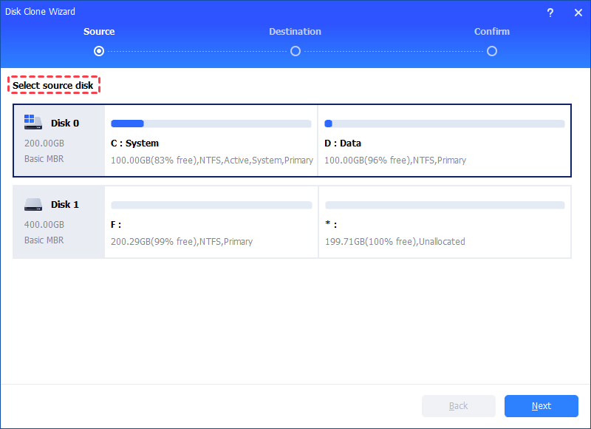
Title: Cloning Disk with AOMEI Software - Step-by-Step
Title: Cloning Disk with AOMEI Software - Step-by-Step

Slide 2
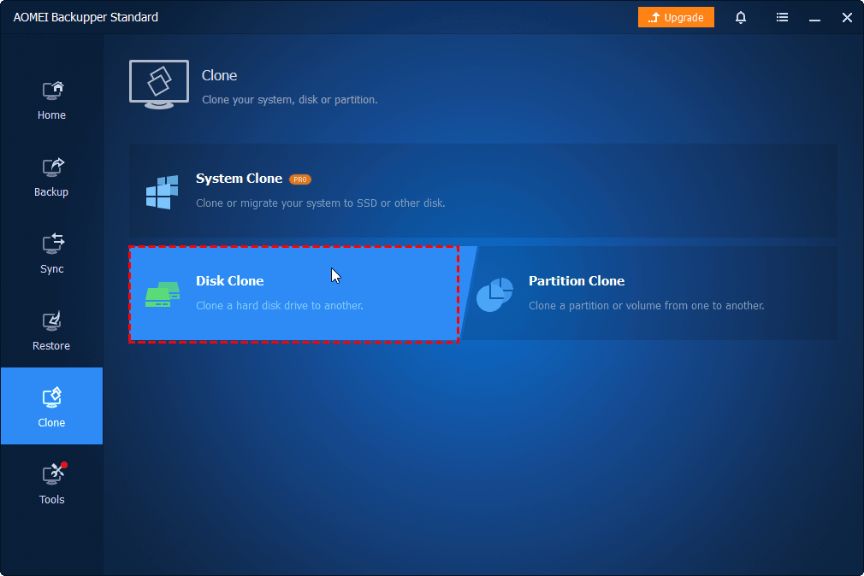
Step 1. To clone a hard drive, select "Disk Clone" option under the "Clone" tab
Step 1. To clone a hard drive, select "Disk Clone" option under the "Clone" tab
Step 5. Click "Finish" when all the disk cloning operations have been done

Slide 3
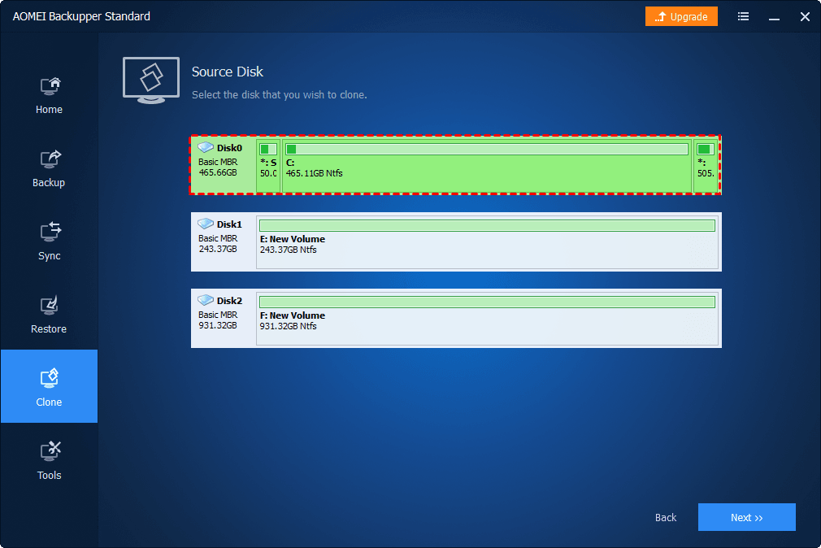
Step 2. Select the source disk (Disk0) which you want to clone, and then click "Next"
Step 2. Select the source disk (Disk0) which you want to clone, and then click "Next"

Slide 4
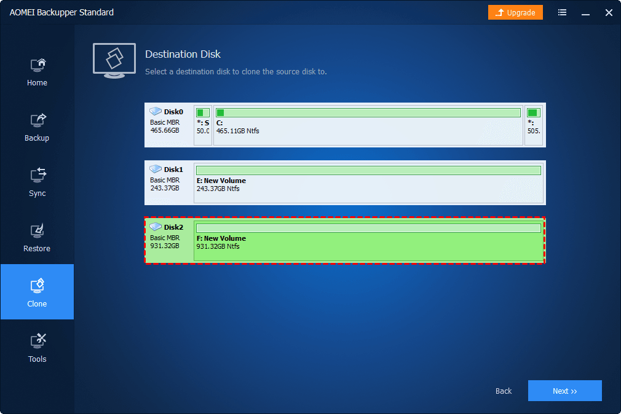
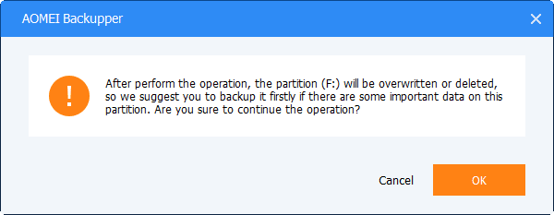
Step 3. Select the SSD as destination disk (Disk1) to store all cloned data, and then click "Next".
Step 3. Select the SSD as destination disk (Disk1) to store all cloned data, and then click "Next".
If the destination disk is not empty, you will be prompted the destination disk will be overwritten or deleted. Click "OK" to continue as you have made a backup before.

Slide 5
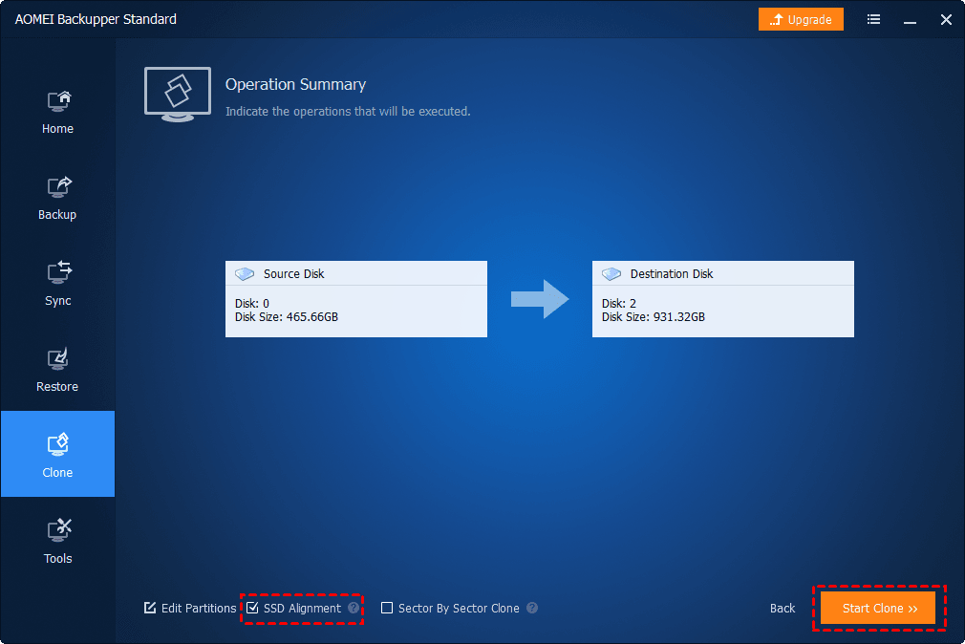
Step 4. As you are cloning hard drive to SSD,
Step 4. As you are cloning hard drive to SSD, it is recommended to check the box before "SSD Alignment" to optimize the performance and lifespan for SSD. Confirm the settings, and then click "Start Clone" to clone HDD to SSD safely. until the cloning is complete

